Slide 1
Business Customer Gateway and Postal Wizard
Express Tutorial
This presentation is a no-frills guide designed for small mailers and contains basic information designed to set up a Business Customer Gateway (BCG) account and submit an electronic statement in Postal Wizard (PW). For more detailed information, access the BCG/PW presentation and recording on PostalPro.
This presentation is interactive. For best results view in presentation mode by selecting the presentation icon
2023
Continue

Slide 2
Discontinuance Of Hardcopy Postage Statements FRN
A Federal Register Notice (FRN) with the final ruling on the discontinuance of hardcopy postage statements was published April 25, 2023, effective January 28, 2024.
Federal Register: Hardcopy Postage Statements Discontinued
Continue

Slide 3
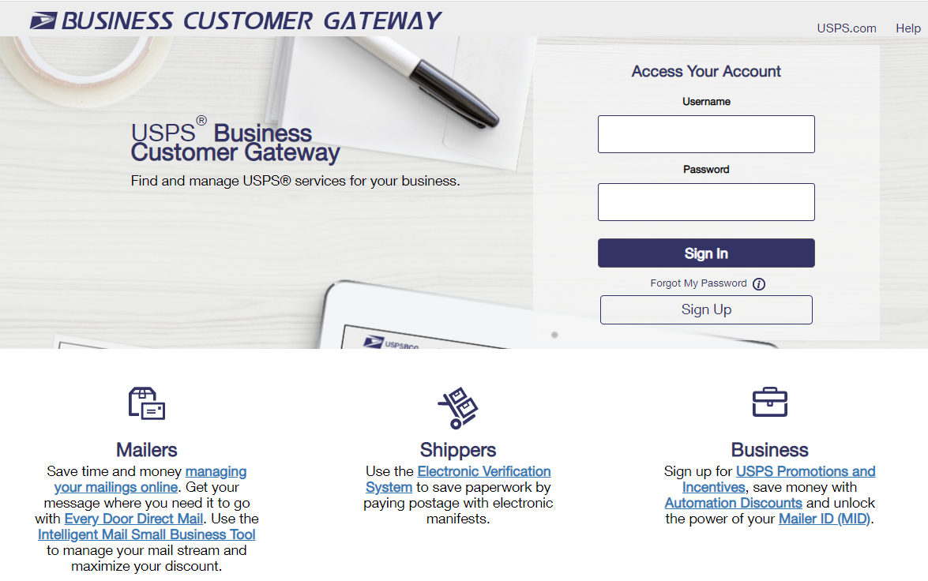
What is the Business Customer Gateway (BCG)?
The Business Customer Gateway is a secure portal to reach mailing and shipping services. These services are accessed through the BCG but are distinct from the site itself. Access to multiple services is provided through a single username and password. Even though they are accessed thru the BCG, the user is taken to a different application. …hence the name “Gateway.”
Please see the example below to see how it works.
User logs in to the Business Customer Gateway (BCG).
User goes to mailing services and clicks on the link for Postal Wizard.
The user is now in the Postal Wizard application and has left the BCG.
Continue

Slide 4
Common BCG Terms
Terms | Abbreviations | Definitions
Business Customer Gateway | BCG | A secure portal to access mailing, shipping, and additional mailing services via a single username and password. Provides a single point of entry for several USPS® online business services. A single BCG account can have many CRIDs.
Customer Registration ID | CRID | A USPS-generated numeric code up to 15 digits that uniquely identifies a business at a location. Use a CRID (company identifier) to establish a Business Customer Gateway account. A CRID can have many permits. A permit is owned by a single CRID at any given time.
Mailer ID | MID | Unique ID number to identify a Mail Owner, Mailing Agent, or Mail Service Provider. Embedded in an IMb. MIDs are either 6 or 9 digits based on calendar year mail volume in PostalOne!. A CRID can have many MIDs. A MID can only be assigned to one CRID.
Business Service Administrator | BSA | Usually, the first person to request service for a business location becomes the BSA of that service and can manage others user's access. Has Managed Mailing Activity. Required to manage permits in BCG.
Business Service Administrator Delegate | BSA Delegate | Acts on behalf of the BSA; can revoke or approve users' access. Has Managed Mailing Activity. Required to manage permits in BCG.
Managed Mailing Activity | MMA | Site of core services, manage permits, balances and fees.
Continue

Slide 5
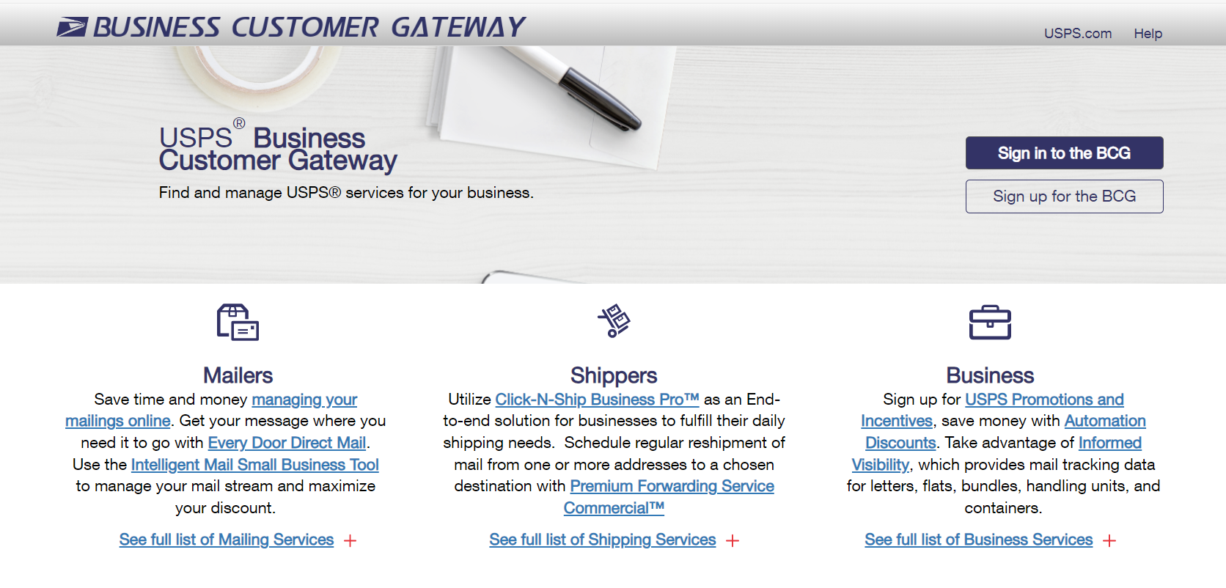
BCG Sign Up
USPS Business Customer Gateway
To access the Business Customer Gateway, go to the end of the page at usps.com® and click on the Business Customer Gateway link. There is also a direct link on this slide.
Click the “Sign Up” button on the home page to get started.
Continue

Slide 6
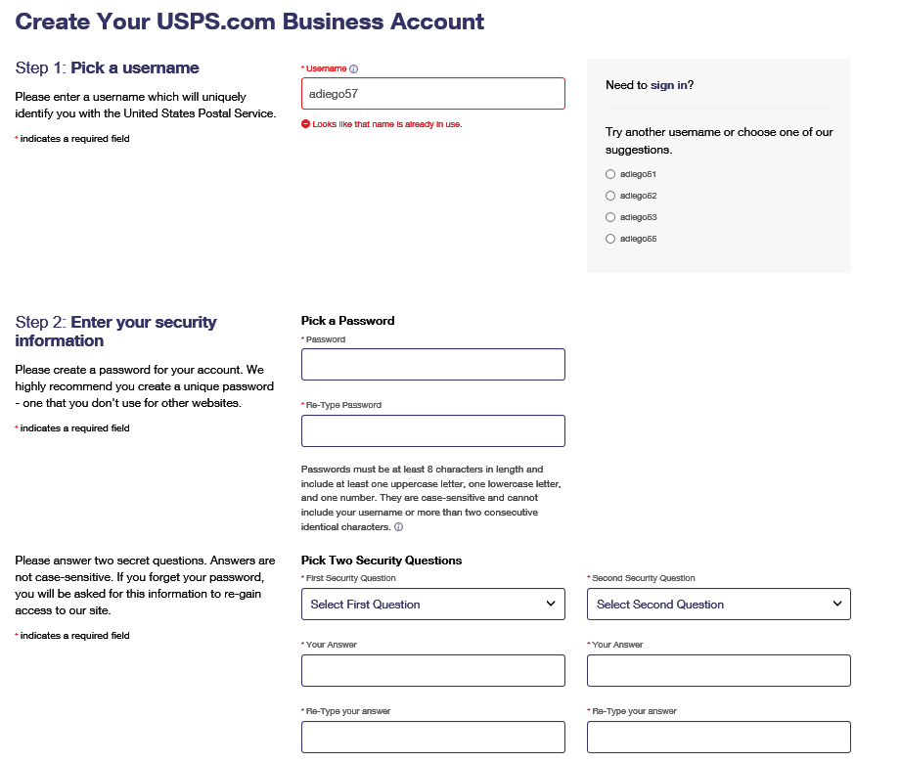
BCG Registration – Initial Steps
1
Create a unique username. (Usernames are case-sensitive)
If the username already exists, the system will provide other options to modify the username.
Select two security questions from the drop-down menus and enter your answers for both.
2
Tip: Write down your username, password, security questions and answers. Store them in a secure location!
If you are unable to remember your password and security questions, you will need to create a new username; not a new BCG.
Continue

Slide 7
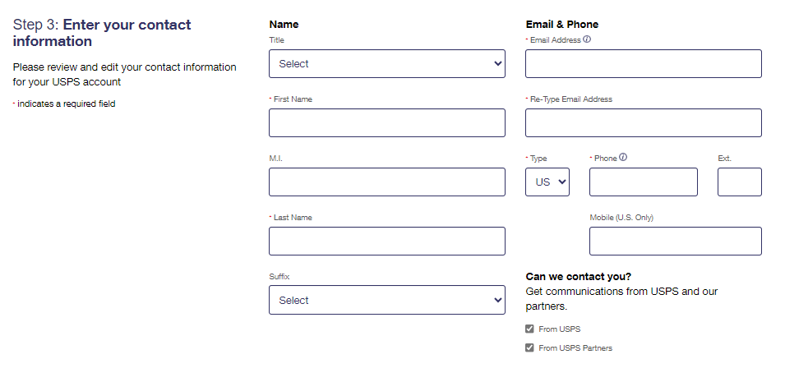
BCG Registration – Contact Information
3
If you do not wish to allow USPS and/or its partners to use this information to contact you, uncheck the boxes accordingly. Both will be checked by default.
Continue

Slide 8
CRID Management
What is a CRID?
A Customer Registration Identification (CRID) number is a USPS-generated numeric code of up to 15 digits that uniquely identifies a business at a specific location. Customers must have a CRID assigned to their business location to be able to access their permits and services in BCG, submit electronic documentation (eDoc), claim Nonprofit rates, and receive Full-Service benefits. Every postal permit is associated to a CRID. The CRID is sometimes also referred to as the Company Identifier.
Select One for Further Instructions
I know my CRID
I have a permit but don’t know my CRID
I don’t have a permit or a CRID
I have a CRID but already set up a BCG account without it.
More Information on CRID Management

Slide 9
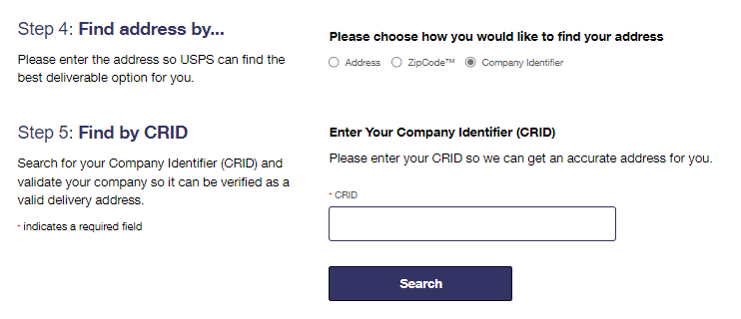
BCG Registration – with a CRID
*If you have an existing CRID, click “Company Identifier” and enter your CRID.
4
5
Continue

Slide 10
I Don’t Know My CRID
If you don’t know your CRID, contact the office where your permit is located or contact the MSSC at 1-877-672-0007 or MSSC@usps.gov.
Return to this presentation after obtaining the CRID associated to your permit.
If you have a permit, you should have a CRID. If you do not have a permit, return to the previous slide by clicking here.

Slide 11
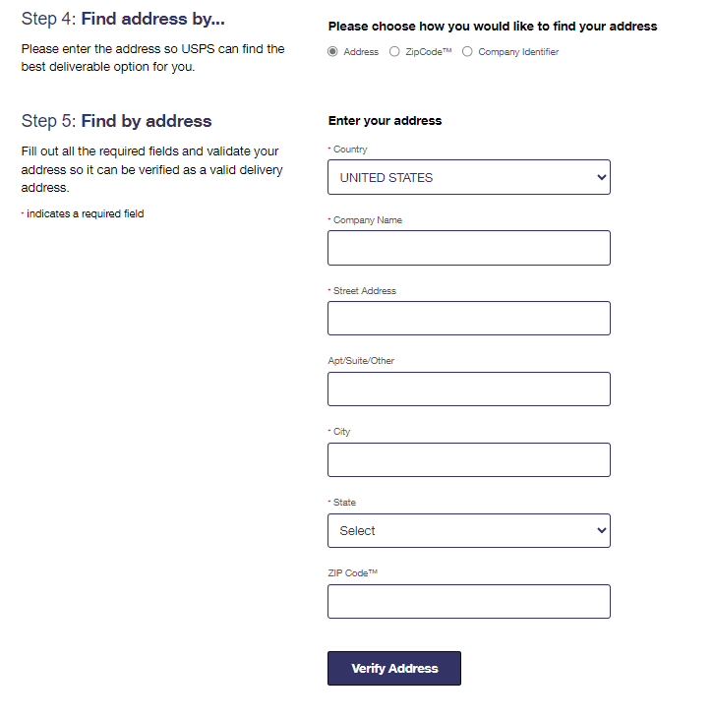
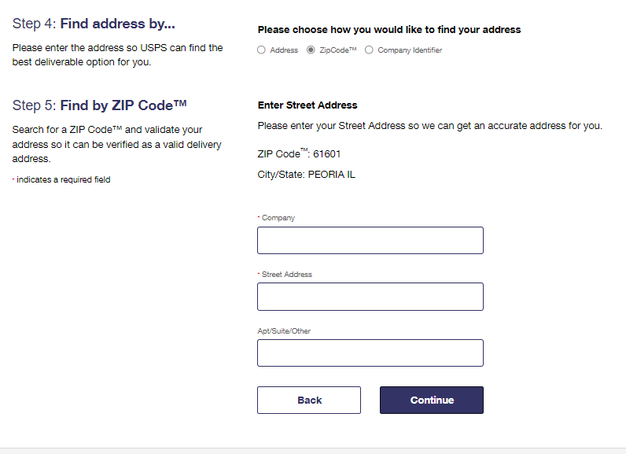
BCG Registration – No Permit or CRID
4
5
Find your address by either Address or ZIP Code™
Continue

Slide 12
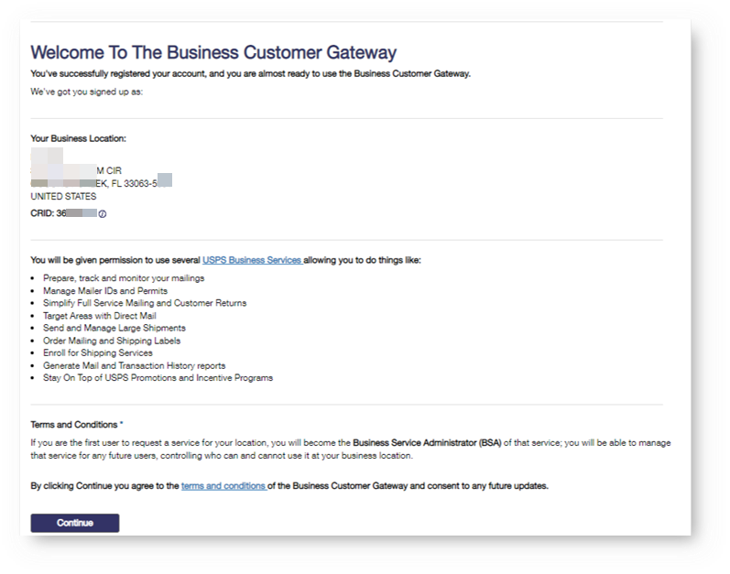
BCG New User Sign Up
The first user at a business location will become the Business Service Administrator (BSA) for a USPS business application or “service.” Any new users after this will have to request access to the CRID and services that the current BSA will approve.
The BSA can be changed later if someone else needs to be made BSA.
The new user must click Continue to complete registration.
Business Location CRID
Services
BSA Acknowledgment
Continue

Slide 13
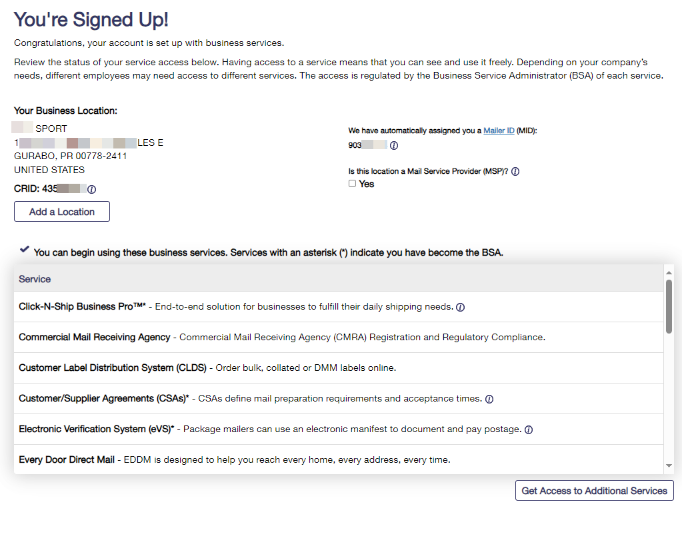
BCG New User Sign Up
Once signed up, you can see your Business Location and CRID along with your Mailer ID or MID. If you are the first user, you are now the BSA of Manage Mailing Activity.
Continue

Slide 14
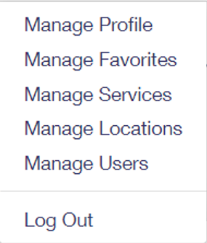
Welcome Page Navigation Bar
Displays system outages and other important information
Business services are located on the top of the home page
Allows BSAs and BSA delegates to edit their account
Allows users to view, approve, and deny any requests for access to services for which they are the BSA
Continue
Notes:
.

Slide 15
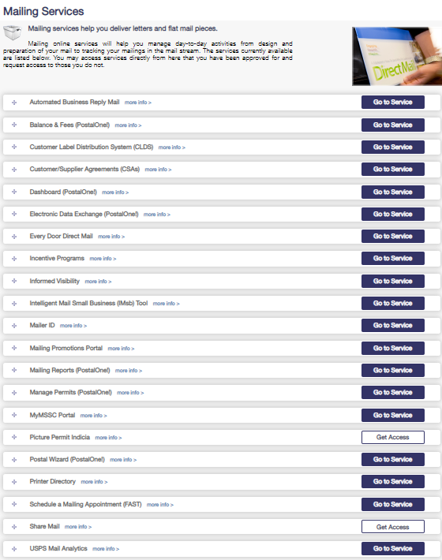
Mailing Services
Commonly used services
Balance and Fees - with EPS, pay fees; set auto pay feature, fee renewal notice; set low balance alert
IMsb Tool - an online tool that will allow mailers to produce the Intelligent Mail barcode (IMb) for mailings.
Manage Permits - see all permits linked to business location and link permits.
Postal Wizard - upload mailings electronically - a tool that gives small-volume mailers a secure, electronic means for submitting postage statements and simplifies calculating postage, checking balance and fees, and viewing mailing reports and mailing history.
Continue

Slide 16
Manage Account Tab
Manage Profile
Allows the user to change their account details such as contact information.
Manage Favorites
Edit the ten shortcuts which are visible on the home page.
Select a tile for more information
Allows the viewing of current services and provides the ability to request access to services.
Manage Services
Manage Locations
Displays all relevant information about the locations currently set up in the account
Manage Users
Allow BSA and BSA delegates to approve/edit user access
Continue

Slide 17
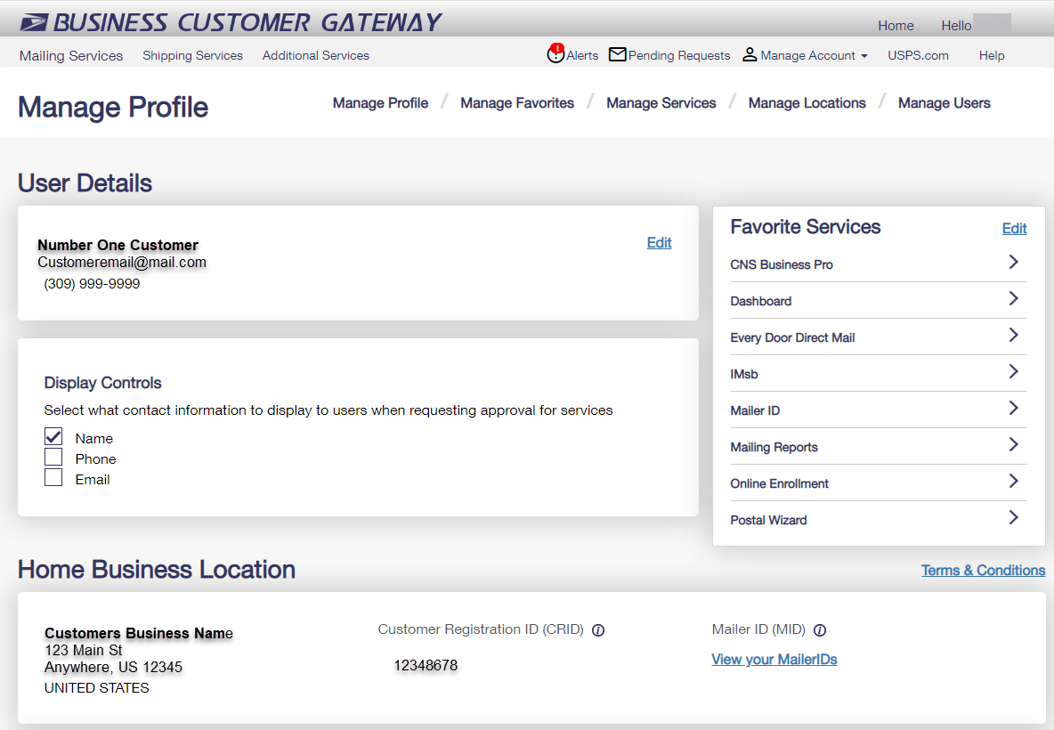
Manage Profile
1. User Details – Edit
Contact info
Change password
Update business address
Change BCG home location
Remove business locations
2. Favorites Services – users can add/edit up to 10 service they have access to
3. Home Business Location
View Mailer IDs
Add Business Location
2
1
3
3
Return to Manage Account Tab slide
Continue

Slide 18
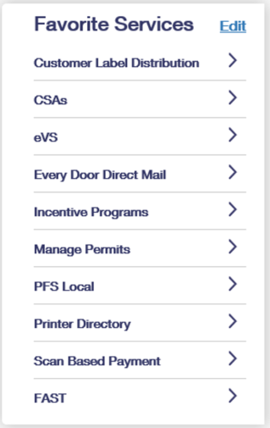
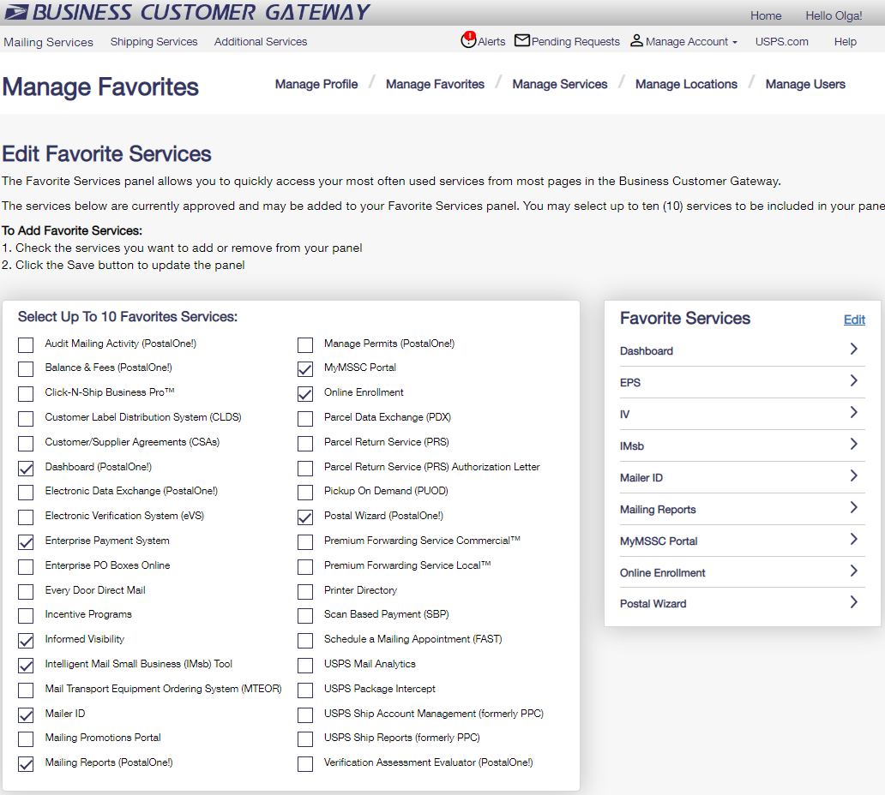
Manage Favorite Services
Allows the user to select up to 10 of their favorite services by clicking on the edit button. Can also be accessed from the Manage Account Menu.
Return to Manage Account Tab slide
Continue

Slide 19
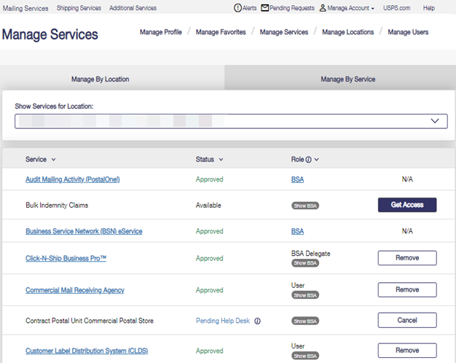
Manage Services
Manage Services by Location or Service
View the status of each service
View your role
BSA – You are the BSA
Show BSA – Not You or No BSA available (click on Show BSA to see the current BSA of service if available)
Get Access/Remove/Cancel – to request access, to remove, or to cancel your access
1
2
3
Return to Manage Account Tab slide
Continue

Slide 20
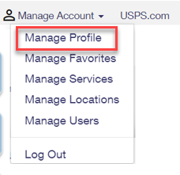
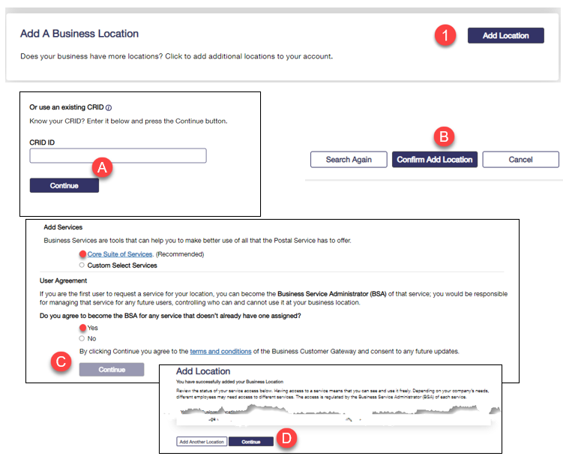
Add a CRID to a BCG Account
After logging in to your account, go to Manage Profile.
Add a location using your CRID.
Enter your CRID and select Continue
Confirm Add Location
Select Services and agree to become the BSA
Verify and Confirm
Continue

Slide 21
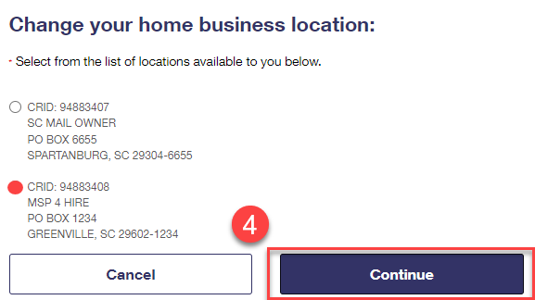
Add a CRID to a BCG Account
Return to Manage Profile.
.
Under User Details, click Edit.
Scroll down and select Change Home Location.
Select your active CRID and Continue.
Continue

Slide 22
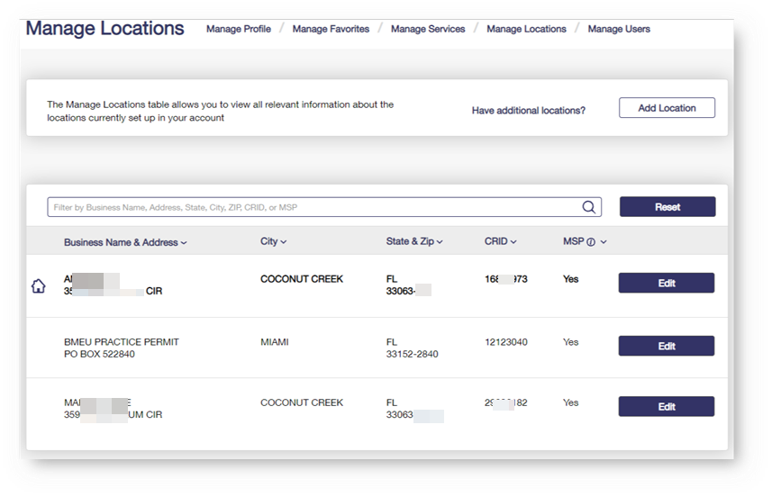
Manage Locations
1
Allows for additional business locations to be added to BCG.
BSA can also edit a business affiliation address or MSP designation.
BSA can also Edit the BCG Home Location.
3
2
123 Main St.
Return to Manage Account Tab slide
Continue

Slide 23
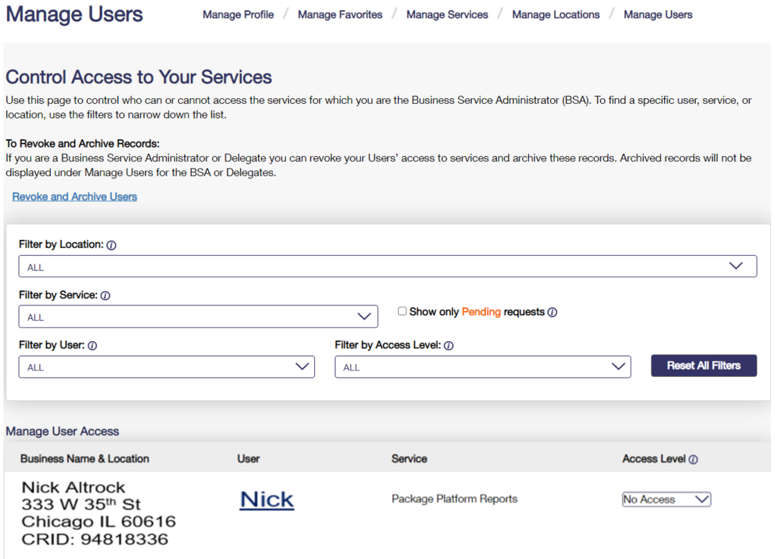
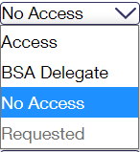
Manage Users
Access: provides user with access to the service for that business location
BSA Delegate allows user to approve/deny requests for that service & location on your behalf
No Access: denies user access to the service for that location
Requested: will default to this when the user has requested access and the BSA has not acted on yet
Return to Manage Account Tab slide
Continue

Slide 24
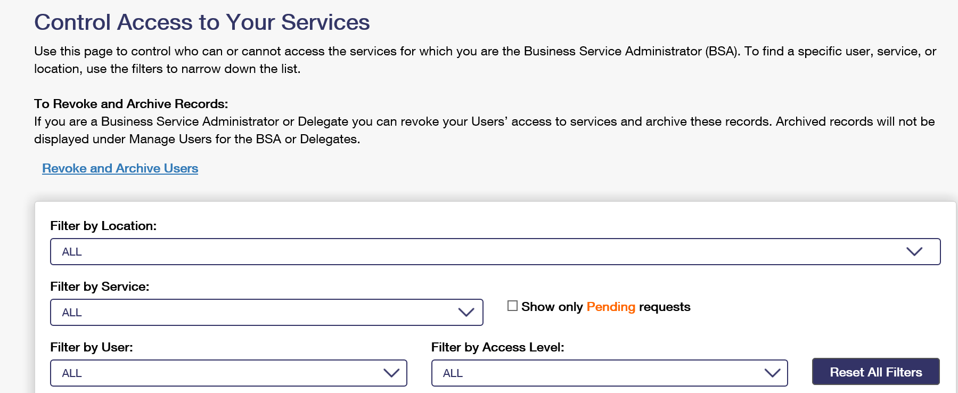
Manage Users – Revoke and Archive
Under manage users, click on revoke and archive
Return to previous Manage Users slide
Return to Manage Account Tab slide
Continue

Slide 25
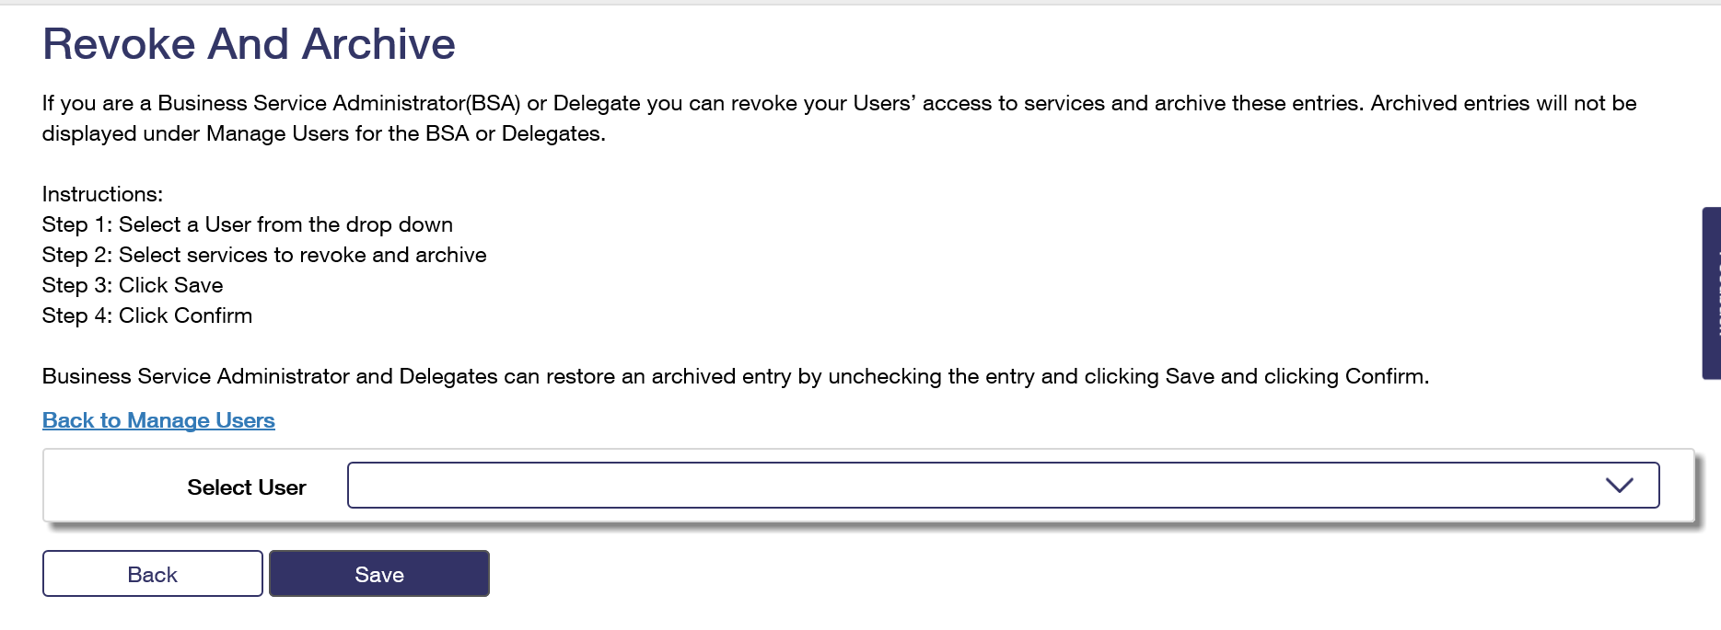
Manage Users – Revoke and Archive
William Pierce
Select the user whose access you wish to change or archive
Return to previous Manage Users slide
Return to Manage Account Tab slide
Continue

Slide 26
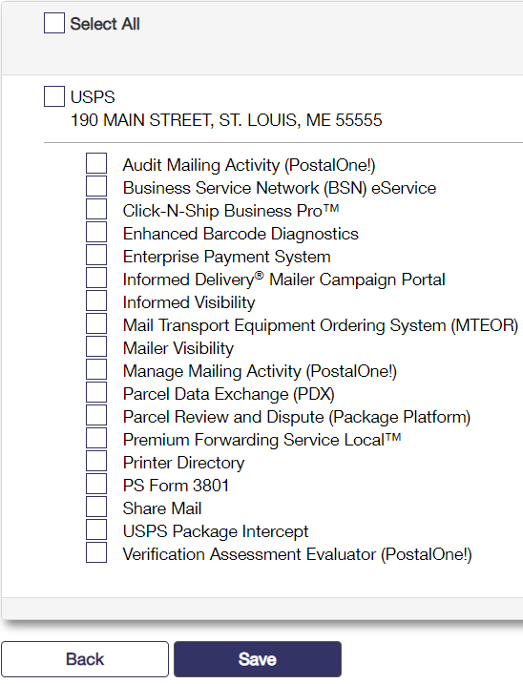
Manage Users – Revoke and Archive
The user and all services assigned to that user appear.
Check the services you wish to revoke and click Save.
In all cases when a service is checked, that means it is revoked.
Next click the Save and confirm that this is the action you wish to take.
William Pierce
A checked box means that user or service is archived
Return to previous Manage Users slide
Return to Manage Account Tab slide
Continue

Slide 27
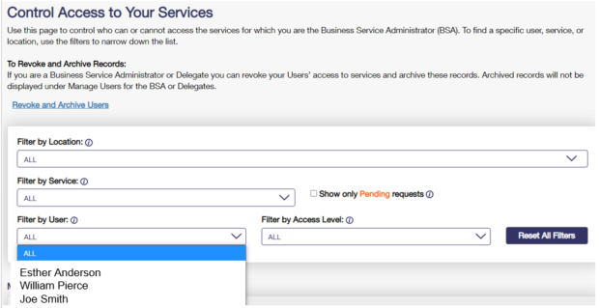
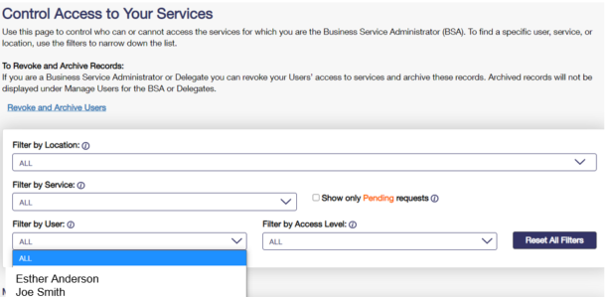
Manage Users – Revoke and Archive
Before all services are removed from William.
After all services are removed from William.
Return to previous Manage Users slide
Users will no longer be visible in the Manage Users section after they have been archived.
Return to Manage Account Tab slide
Continue
27

Slide 28
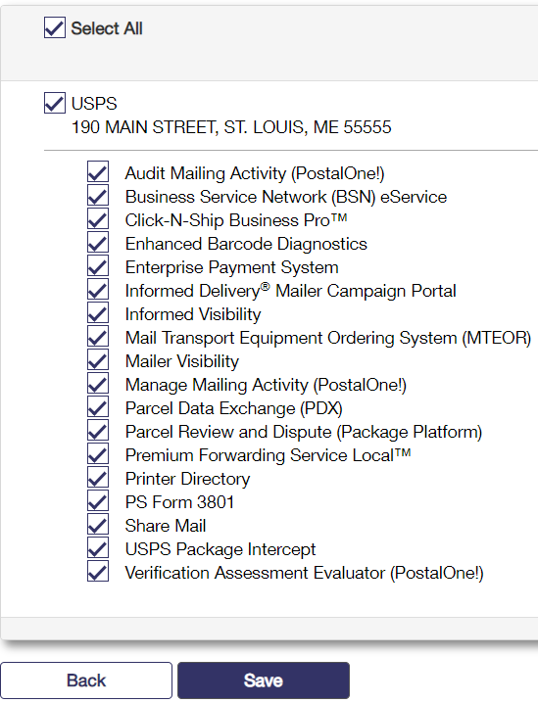
Manage Users – Revoke and Archive
To unarchive a user, uncheck the service you wish to see in Manage Users.
Restoring any or all the services will allow the user to appear on the manage users screen.
If all services were removed from the user or if the user was removed from the main CRID, then that user cannot be restored.
Please note: A user who has a service restored will have to be approved for that service again by the BSA. This can be accomplished in Manage Users.
A checked box means that user or service is archived.
Return to previous Manage Users slide
Return to Manage Account Tab slide
Continue

Slide 29
Manage Users – Revoke and Archive
When returning to that user in revoke and archive, those services which were archived appear with checkmarks
To restore the archived user and records, uncheck the services you would like to return to appear in Manage Users for that user
Return to previous Manage Users slide
Return to Manage Account Tab slide
Continue
29

Slide 30
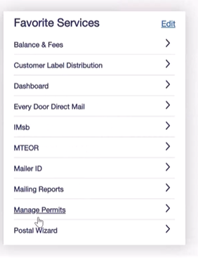
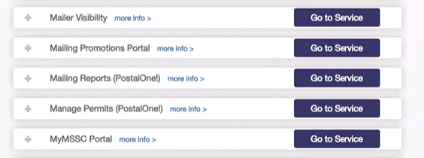
Permit Accounts
Access Manage Permits through Mailing Services or on the Favorite Services widget.
Select the Business Location for which you want to mange the permit (you many only have one listed)
Continue

Slide 31
Permit Accounts
Scroll down to the permit tabs.
Select One for Further Instructions
Verify My Permit
Link My Permits
Apply for New Permits

Slide 32
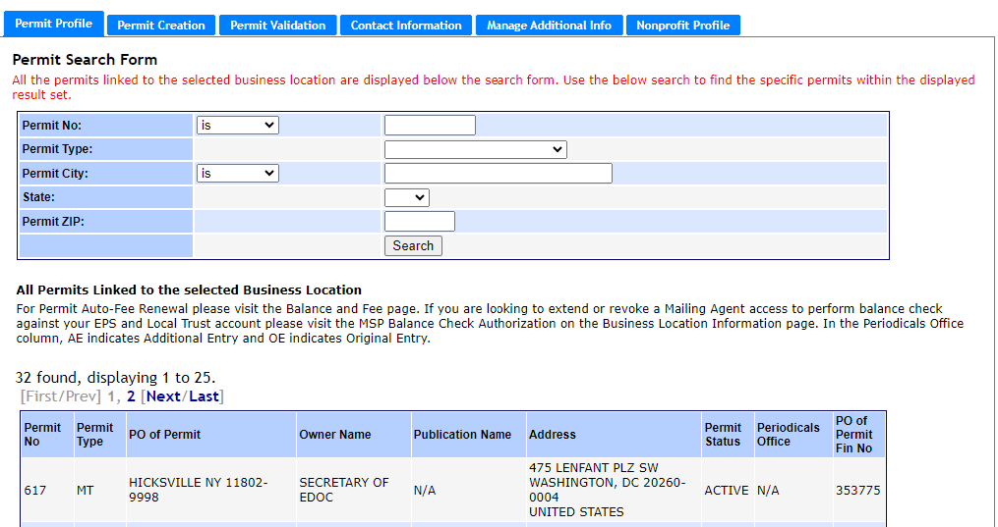
Verify Permits in BCG
Select the Permit Profile tab. If your permit is not listed, you will need to link the permit to your account.
Link My Permits
My Permits are linked, Continue
Return to Permit Account Selection

Slide 33
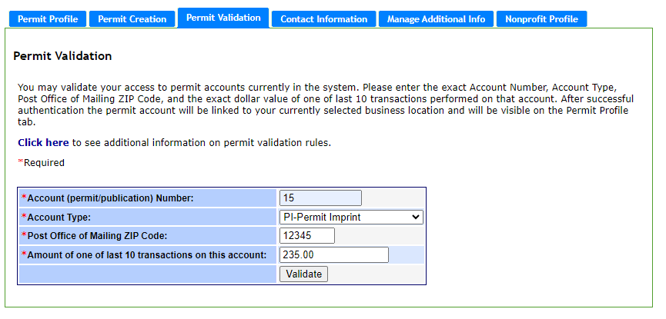
Link Permits to BCG
Select the Permit Validation tab, enter your permit information, and click Validate. If you haven’t used the permit for mailing yet, you can use the application fee in the transaction amount field. If you have had no transactions, you must contact the MSSC to link your permit.
Return to Permit Account Selection
My Permits are now linked, Continue

Slide 34
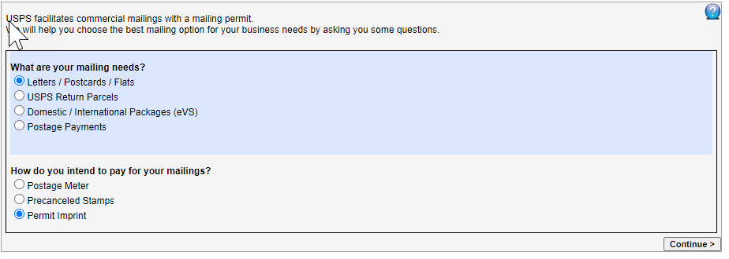
Create Permits in BCG
Select the Permit Creation tab.
Select the Walk-me Through button
Return to Permit Account Selection
Choose your mail type and permit type and continue
Continue

Slide 35
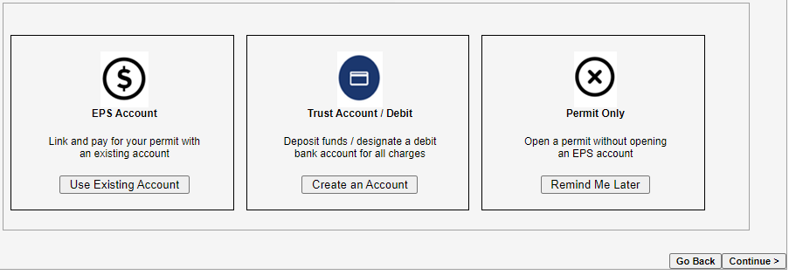
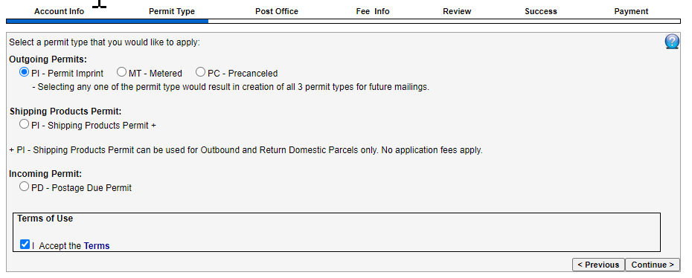
Create Permits in BCG continued
If you wish to link to an EPS Account or create a trust account (optional) you can make those selections here; otherwise, click Continue.
Select the permit type, accept the terms and click Continue
Return to previous Create Permits slide
Return to Permit Account Selection
Continue

Slide 36
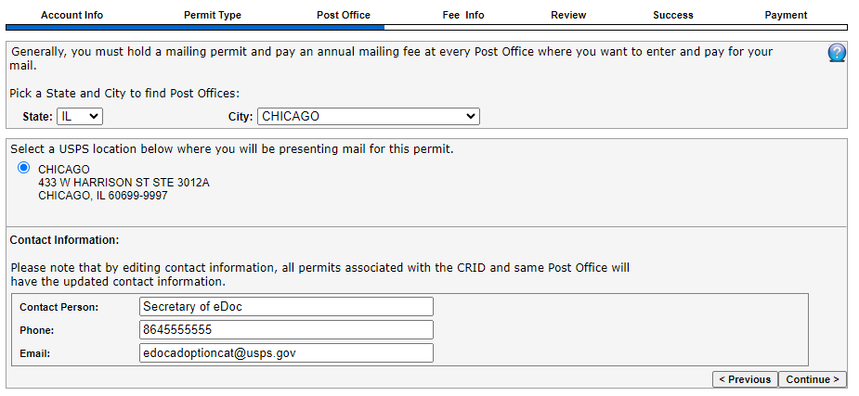
Create Permits in BCG continued
Select the location for your permit and click Continue
Verify the information on the rest of the screens and continue. If you did not set up and EPS or Trust Account, go to the office you chose for your permit location to make your payment.
Return to previous Create Permits slide
Return to Permit Account Selection
Continue

Slide 37
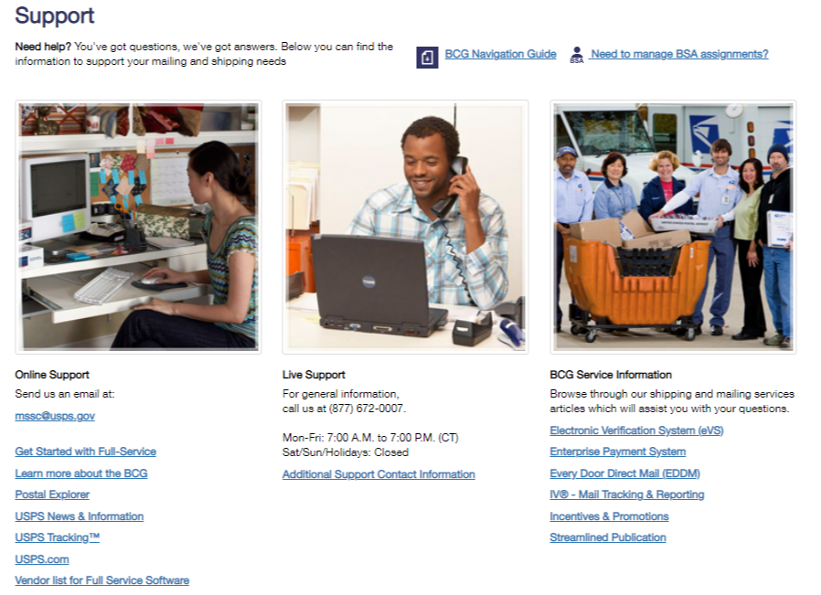
Help Options
Continue

Slide 38
BCG Resources
Business Customer Gateway Home Page
Business Customer Gateway Help Page
Business Customer Gateway Resources on PostalPro
CRID Management
Return to the Beginning of the BCG Presentation
Continue to the Postal Wizard Presentation

Slide 39
Postal Wizard
Postage Statement Entry
Postal Wizard is an online tool that gives mailers a secure, electronic means for submitting postage statements.
Users must have a Business Customer Gateway (BCG) Account with an active mailing permit linked to their BCG account before using Postal Wizard.
2023
Back
Continue

Slide 40
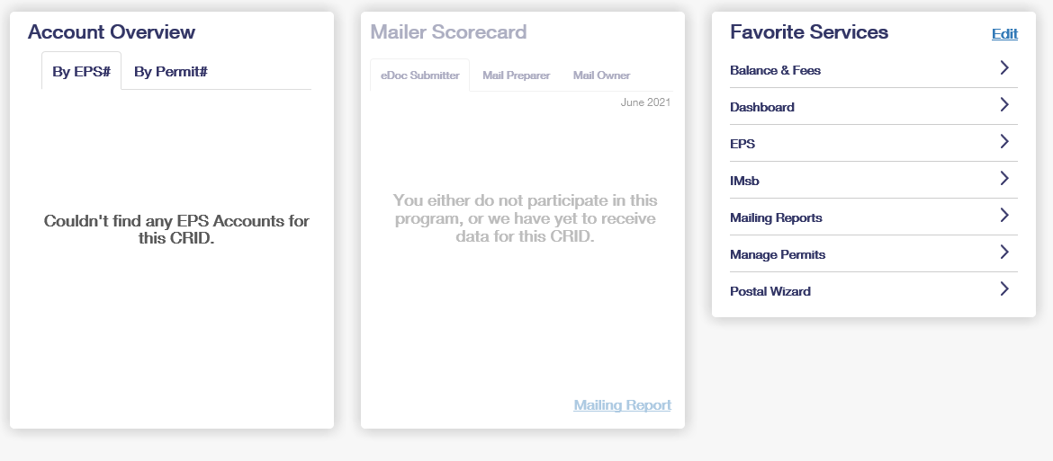
Mailing Services Tab – Select Postal Wizard
You can locate Postal Wizard by clicking on the Mailing Services tab. You can also save it as a favorite under Favorite Services.
Back
Continue

Slide 41
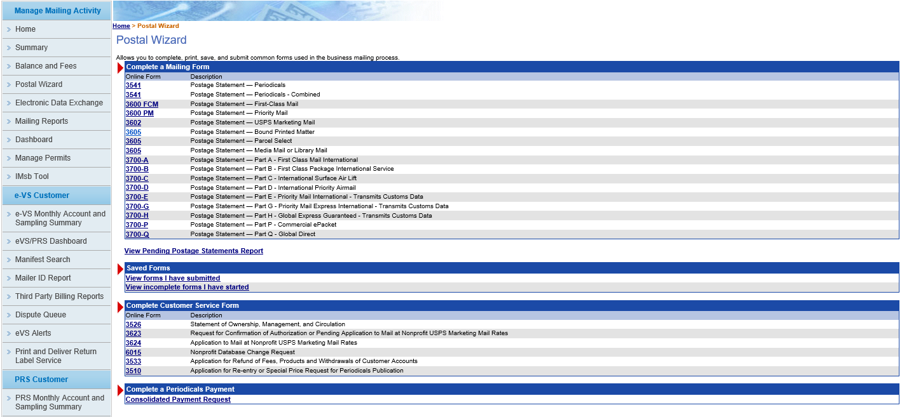
Statement Information – Select Your PS Form
All of the available, up-to-date postage statements are listed. From this page, choose the form number to be completed.
Back
Continue

Slide 42
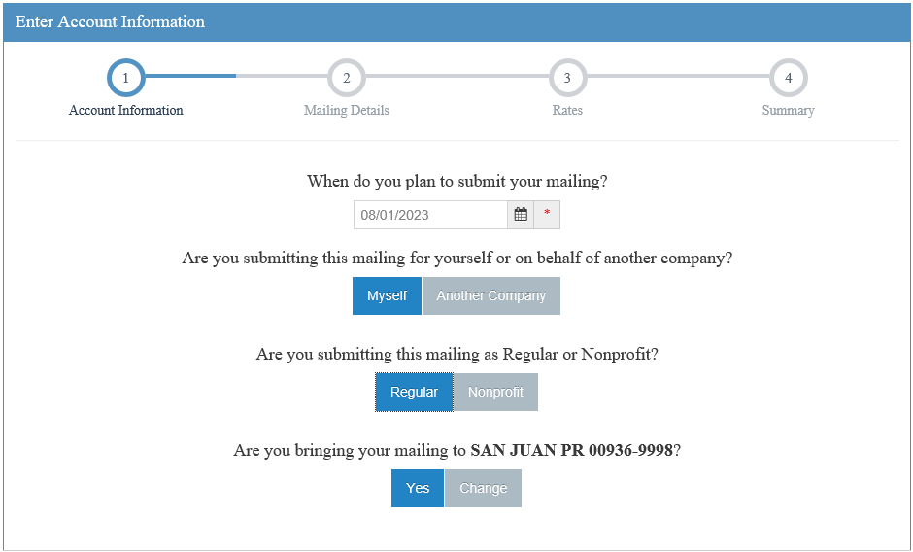
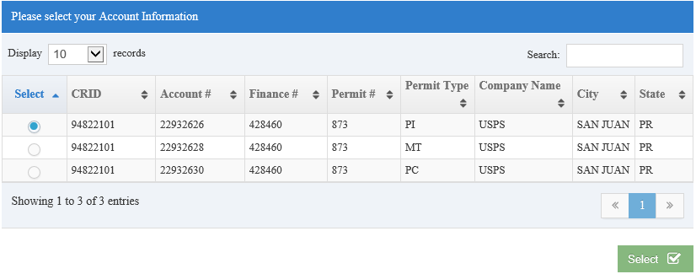
Account Information Selections (Regular/Nonprofit)
Next, answer these questions.
After selecting Myself or another company, you will select the permit you wish to use for the mailing.
Back
Continue

Slide 43
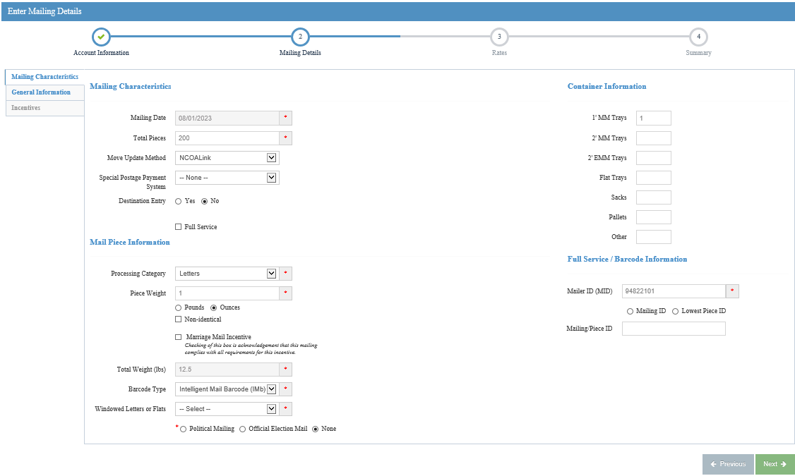
Mailing Characteristics
After answering those questions, you are going to fill in the requested information. This is the same information you enter on a hardcopy statement
Under mailing characteristics, enter the total number of pieces, Move Update method, and if you’re claiming Destination entry discounts or are submitting a Full-Service mailing.
Under Mail Piece Information, you will select the processing category of mail (letters, flats, or parcels) and weight of a single piece. The total weight will calculate for you.
Enter the container information and click Next to continue.
Back
Continue

Slide 44
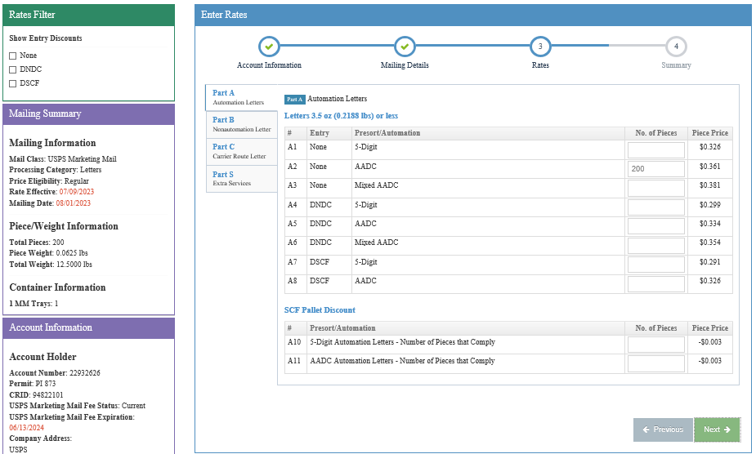
Rates – Enter Piece Counts
Now, enter your piece counts on the appropriate price line depending on the sortation and entry of the mailing. This again is the same way you would enter on the hardcopy statement.
Click next.
You may need to select a tab to get to the correct section
Enter piece counts on the proper price lines.
Back
Continue

Slide 45
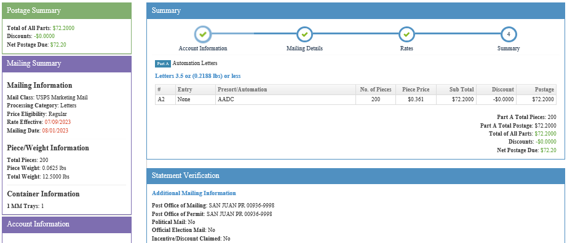
Summary Screen – Verify Information
The mailing is totaled. Review your entries and make sure everything has been entered accurately. If not, go back and make corrections.
Back
Continue

Slide 46
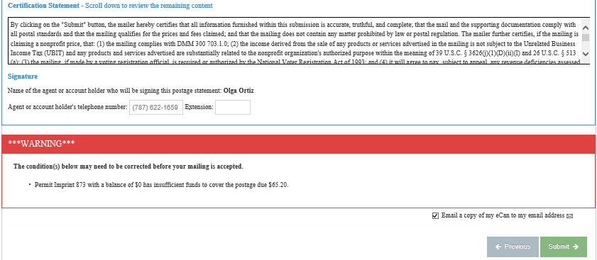
Statement Submission – Read Certification Statement and Submit
Scroll to bottom of the summary page, read the certification statement, and click submit, which will take you to the confirmation page.
Back
Continue

Slide 47
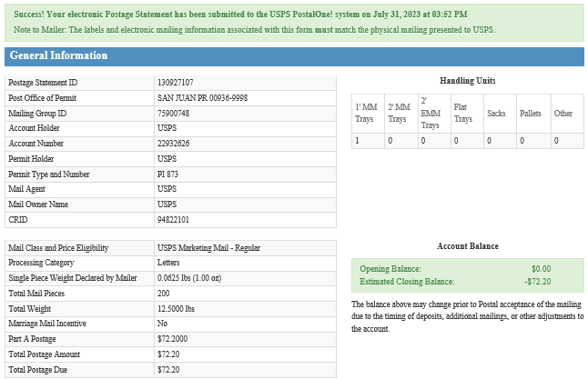
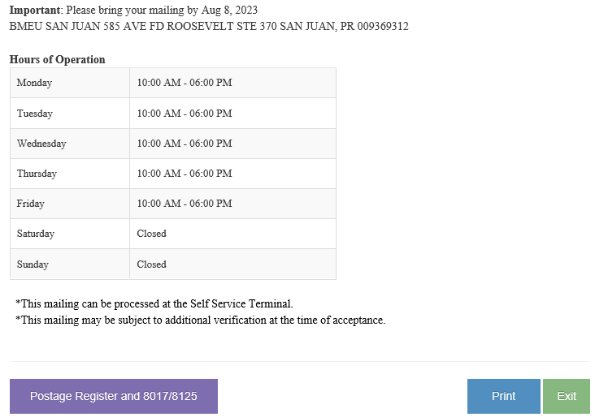
Confirmation Page
Success! Your electronic Postage Statement has been submitted to the USPS PostalOne! system on…and it will have the date and time of submission. To print your confirmation page, select Print.
Note: The labels and electronic mailing information associated with this form must match the physical mailing presented to USPS.
Back
Continue

Slide 48
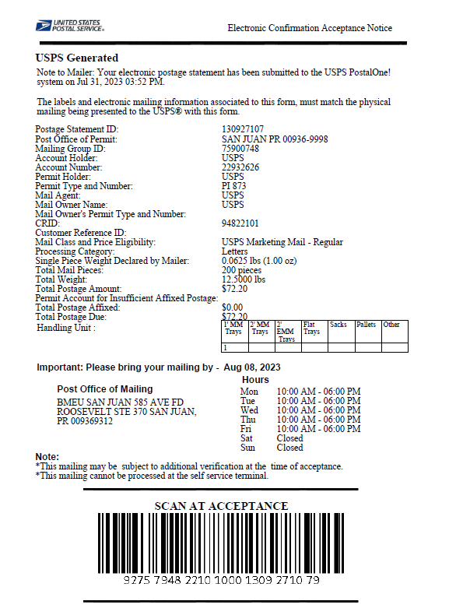
Confirmation Page
Print the confirmation page and present it with your mailing at the acceptance office.
If you submit a job in error, you can navigate to your dashboard and cancel the statement.
You are not charged any postage until the mail is presented or the statement has been finalized.
Back
Continue

Slide 49
Resources
Postal Wizard Fact Sheet | PostalPro (usps.com)
How to Submit a Postal Wizard Mailing
Business Customer Gateway Postal Wizard Recorded Training
Business Customer Gateway Postal Wizard Detailed Presentation
Electronic Documentation (eDoc) Fact Sheet | PostalPro (usps.com)
For additional questions, please reach out your local BME or to the Mailing and Shipping Solutions Center (MSSC).
1-877-672-0007
mssc@usps.gov
Return to the Beginning of the BCG Presentation
Return to the Beginning of the Postal Wizard Presentation

